Slide 1
Vedantu
Investment Report

Slide 2
SIMILAR COMPANIES
Chegg
Varsity tutors
Tal & other Chinese players
Skooli
knack
Tutor.com

Slide 3
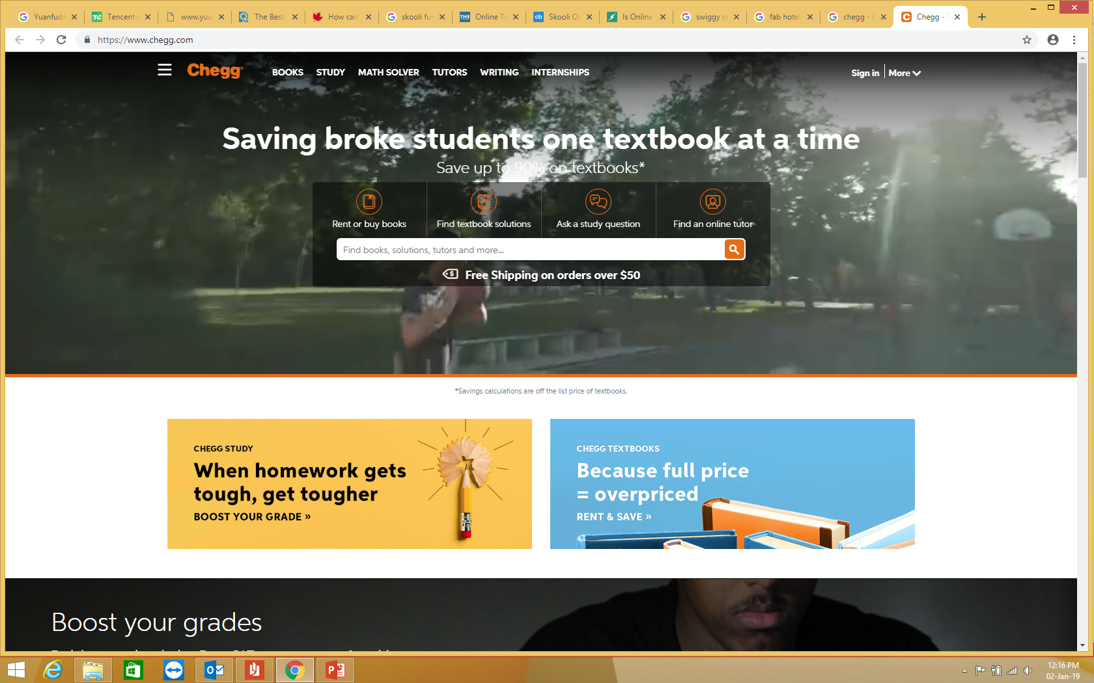
Chegg (2005, California) Valuation at IPO. $1.1B, 2013
Started as an online textbook rental platform. Now also sells books, provides textbook solutions and helps student find internships and scholarships.
Now it has become one of the largest player of online tutoring globally. Through Chegg, a student in India can choose a tutor from an elite university abroad.
Charges only $15/week for 30 minutes of 1:1 tutoring.
Apart from tutoring, teachers can also earn by providing solutions to the questions posted.

Slide 4
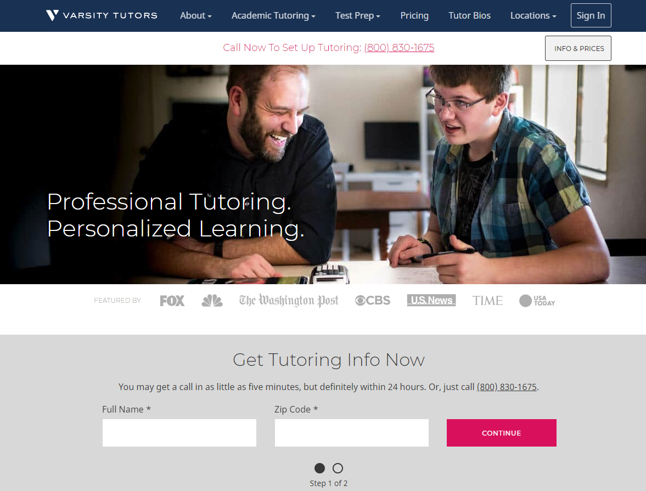
Varsity Tutors (2007, Missouri) raised $ 50 Mil in series C in Feb 2018
Varsity Tutors has raised $107 Mil till date. Apart from online tutoring it also provides in person tutoring.
Experts are available to meet in person or through the Company’s award-winning online and mobile platforms.
Since inception, Varsity Tutors has logged 3 million hours of live one-on-one tutoring, with more than 40,000 experts on the platform, across 1,000 subjects.
It plans to quickly expand globally with the recent funding.

Slide 5
TAL Education Group
K-12 tutoring services in China and has enjoyed profitable growth and a rising stock price. Since 2013, its revenues have grown at a 50% compound annual rate to $1.7 billion with a 2017 net margin of 12%. In 2018, its stock price has increased 39% to a market capitalization of $23 billion.
It faces no international competition due to regulations and language barriers faced by foreign tutoring companies.
Competitor New Oriental provides tutoring services in China and has grown more slowly with higher profitability and a slightly rising stock price. Since 2013, its revenues have grown at a 19.1% compound annual rate to $1.8 billion with a 2017 net margin of 15%. In 2018, its stock price has increased 3.3% to a market capitalization of $15 billion.

Slide 6
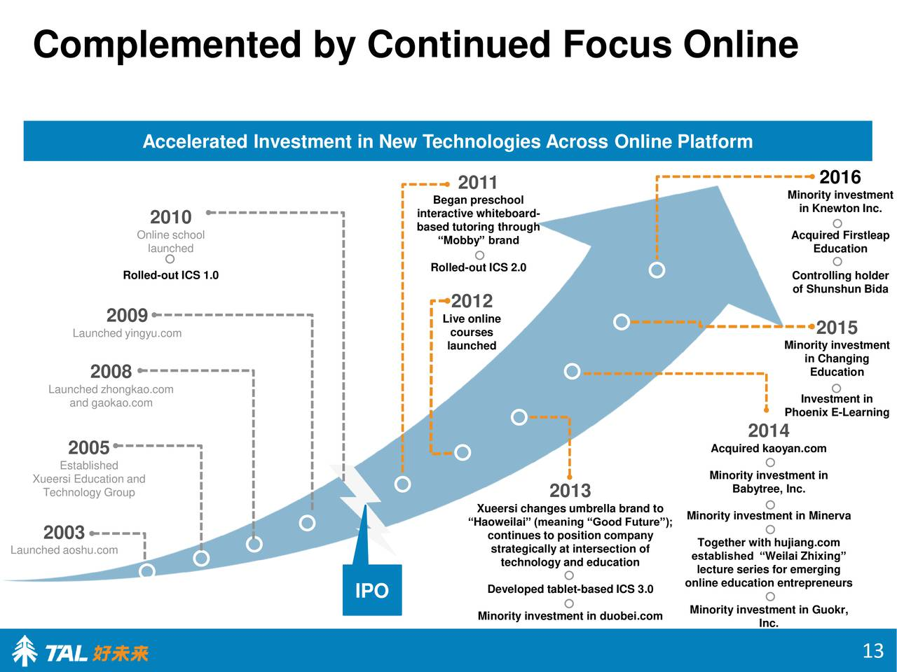
TAL Investments
TAL acquired CodeMonkey, a Israel-based company founded in 2013, which offers children interactive online coding lessons. More than 75 percent of primary and middle schools use its products. It also aquired Dr. Panda, which has become one of the largest developers of paid education apps for children
TAL invested in Knewton in 2016 which provides students with tailored recommendations for exactly what to study, teachers with analytics to better support each student, and publishers with content insights to develop more effective digital products.
This shows that TAL will be interested in investing in companies like Embibe, Byju’s etc with creative content and AI based analytics. It already has online tutoring platform which it is using to expand globally. There is no past investment outside China in online tutoring startups.

Slide 7
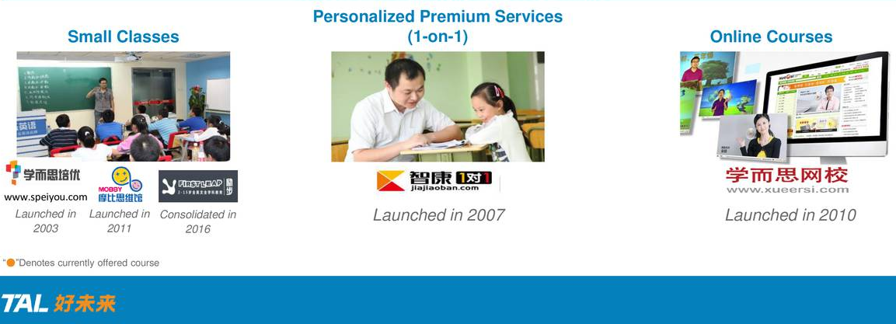
The Company Making Billions Off China’s Worried Parents. The weekend ritual for many American kids includes hanging out with friends, sports, etc. Steven, a 9-year-old student in Beijing, spent a recent Friday evening in a tutoring center operated by TAL Education Group, cramming mathematics. On Saturday he was back for extra instruction in English and Chinese. No one has to force them to study, because even elementary school students in testing-obsessed China know the importance of doing well on the dreaded national exams. Those who do poorly can end up in dead-end livelihoods with no chance of college admission. That’s why many parents are gladly willing spend $3,124/ year - to guarantee a bright future for their offspring. That desire has also turned TAL, the nation’s largest tutoring outfit, into a major money spinner.
How does tal makes so much money ?
TAL provides in-person coaching (lively classes & and students get to play little games while learning ) and online. TAL expects this year to tutor 1.9 million students—double the enrollment of the New York City public school system.

Slide 8
TAL Fourth Quarter of Fiscal Year 2018
Total student enrollments increased by 95.7% year-over-year to approximately 2,615,760 from approximately 1,336,600 in the same period of the prior year.
Total physical network increased from 507 learning centers in 30 cities as of February 28, 2017 to 594 learning centers in 42 cities as of February 28, 2018, located in 42 key cities.
The increase in total student enrollments was driven primarily by the growth of enrollments in the small class offerings and online courses.

Slide 9
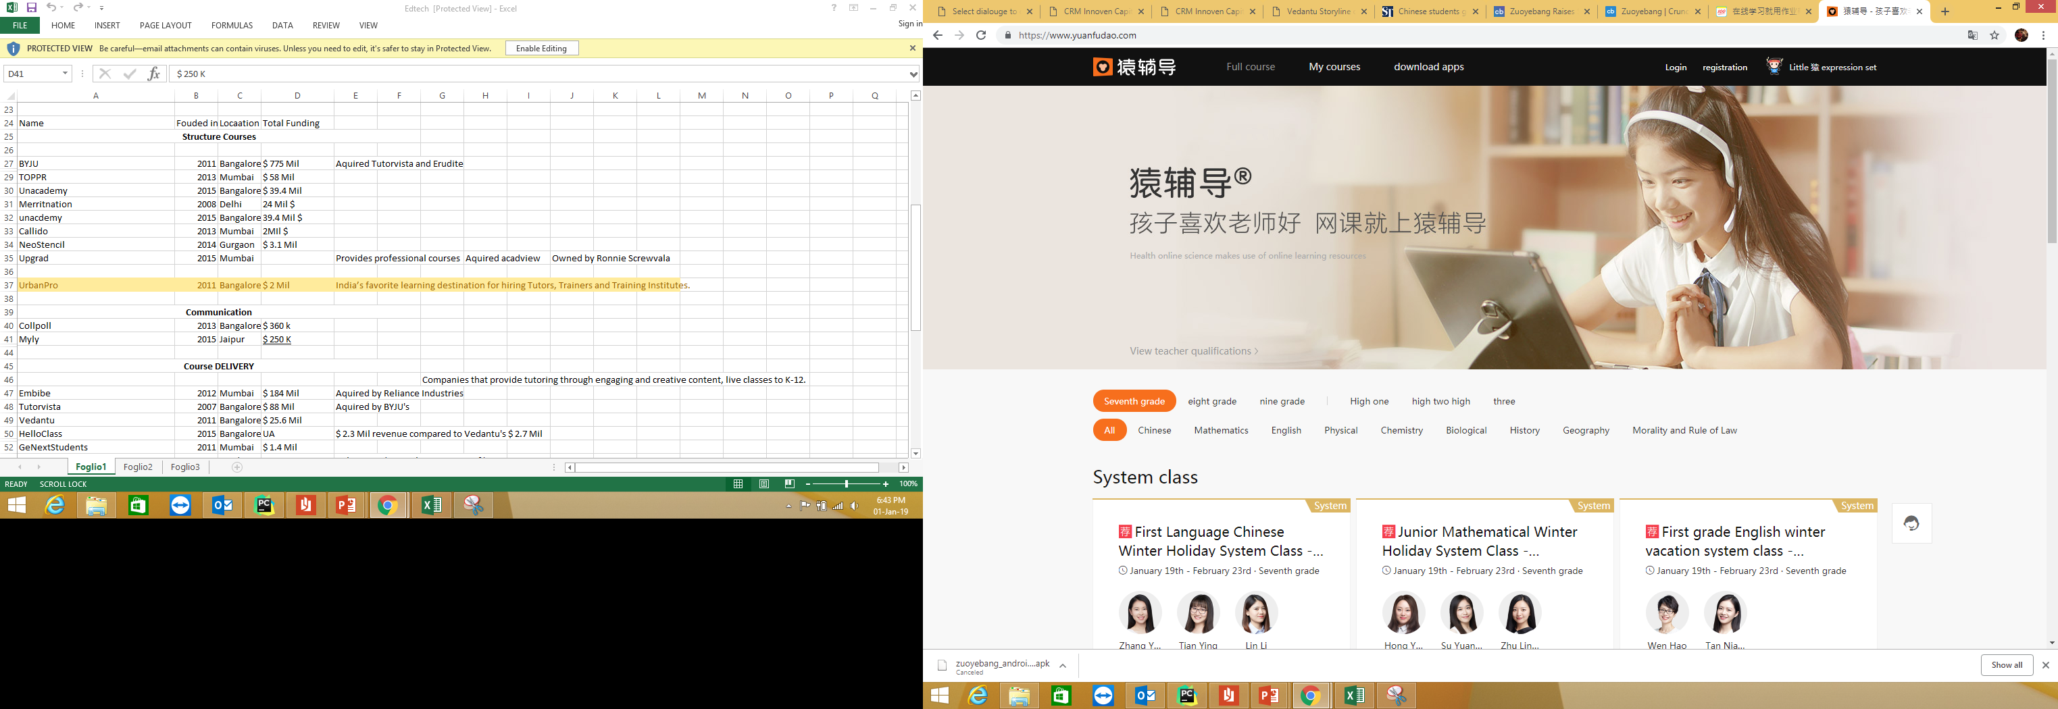
New players in China
Zuoyebang (2014, Beijing) currently cooperates with 113 educational organizations and 370,000 primary schools and high schools in China. It has raised more than $585M till date.
Zuoyebang is an online education platform where K-12 students can upload their homework questions and search for solutions.
It has started branching into live-streaming online courses and one-on-one tutoring for kids.
Yuanfudao (2012) Raised $300 Million From Tencent at $3 Billion Valuation in Dec 2018.

Slide 10
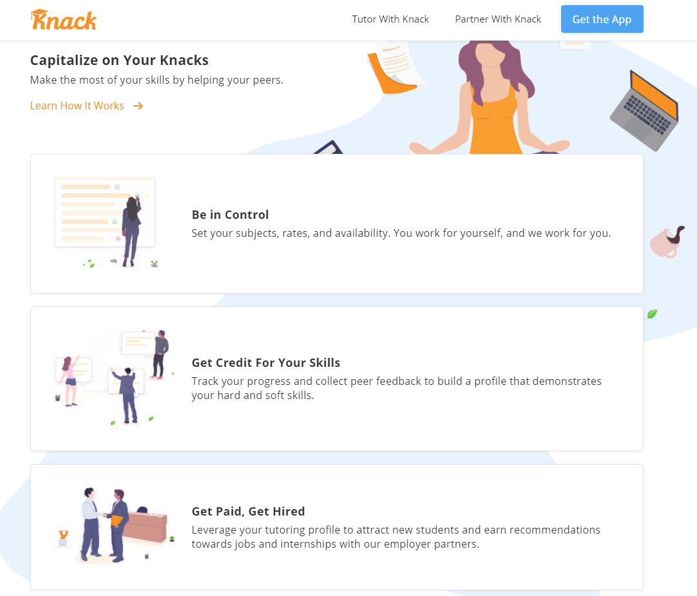
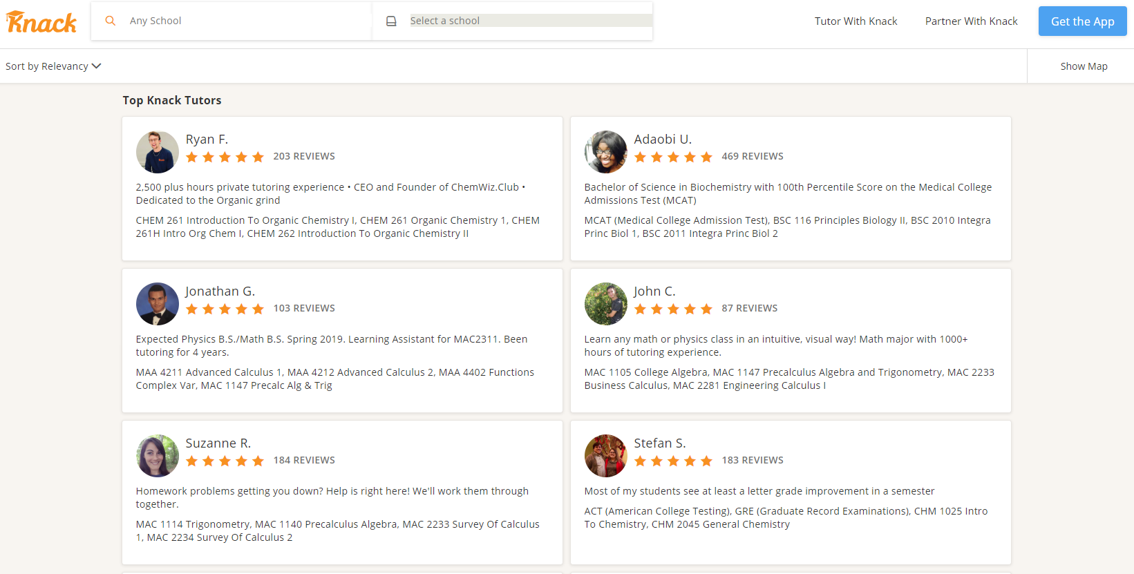
Knack (2016, Florida) raised $ 1.5 Mil in seed round in Nov, 2018
The company has connected with professors from a large no. of colleges in USA.
Tutor sessions can be generated into a progress report and this can be used as credit or recommendation helping in career as professor.
.

Slide 11
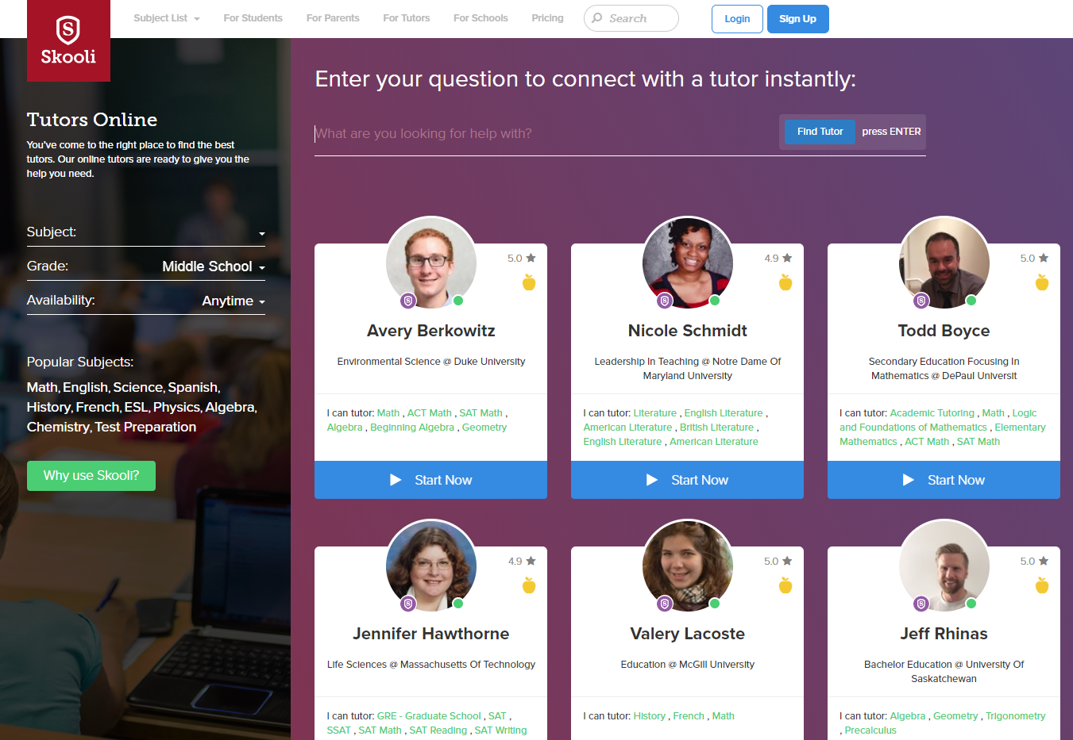
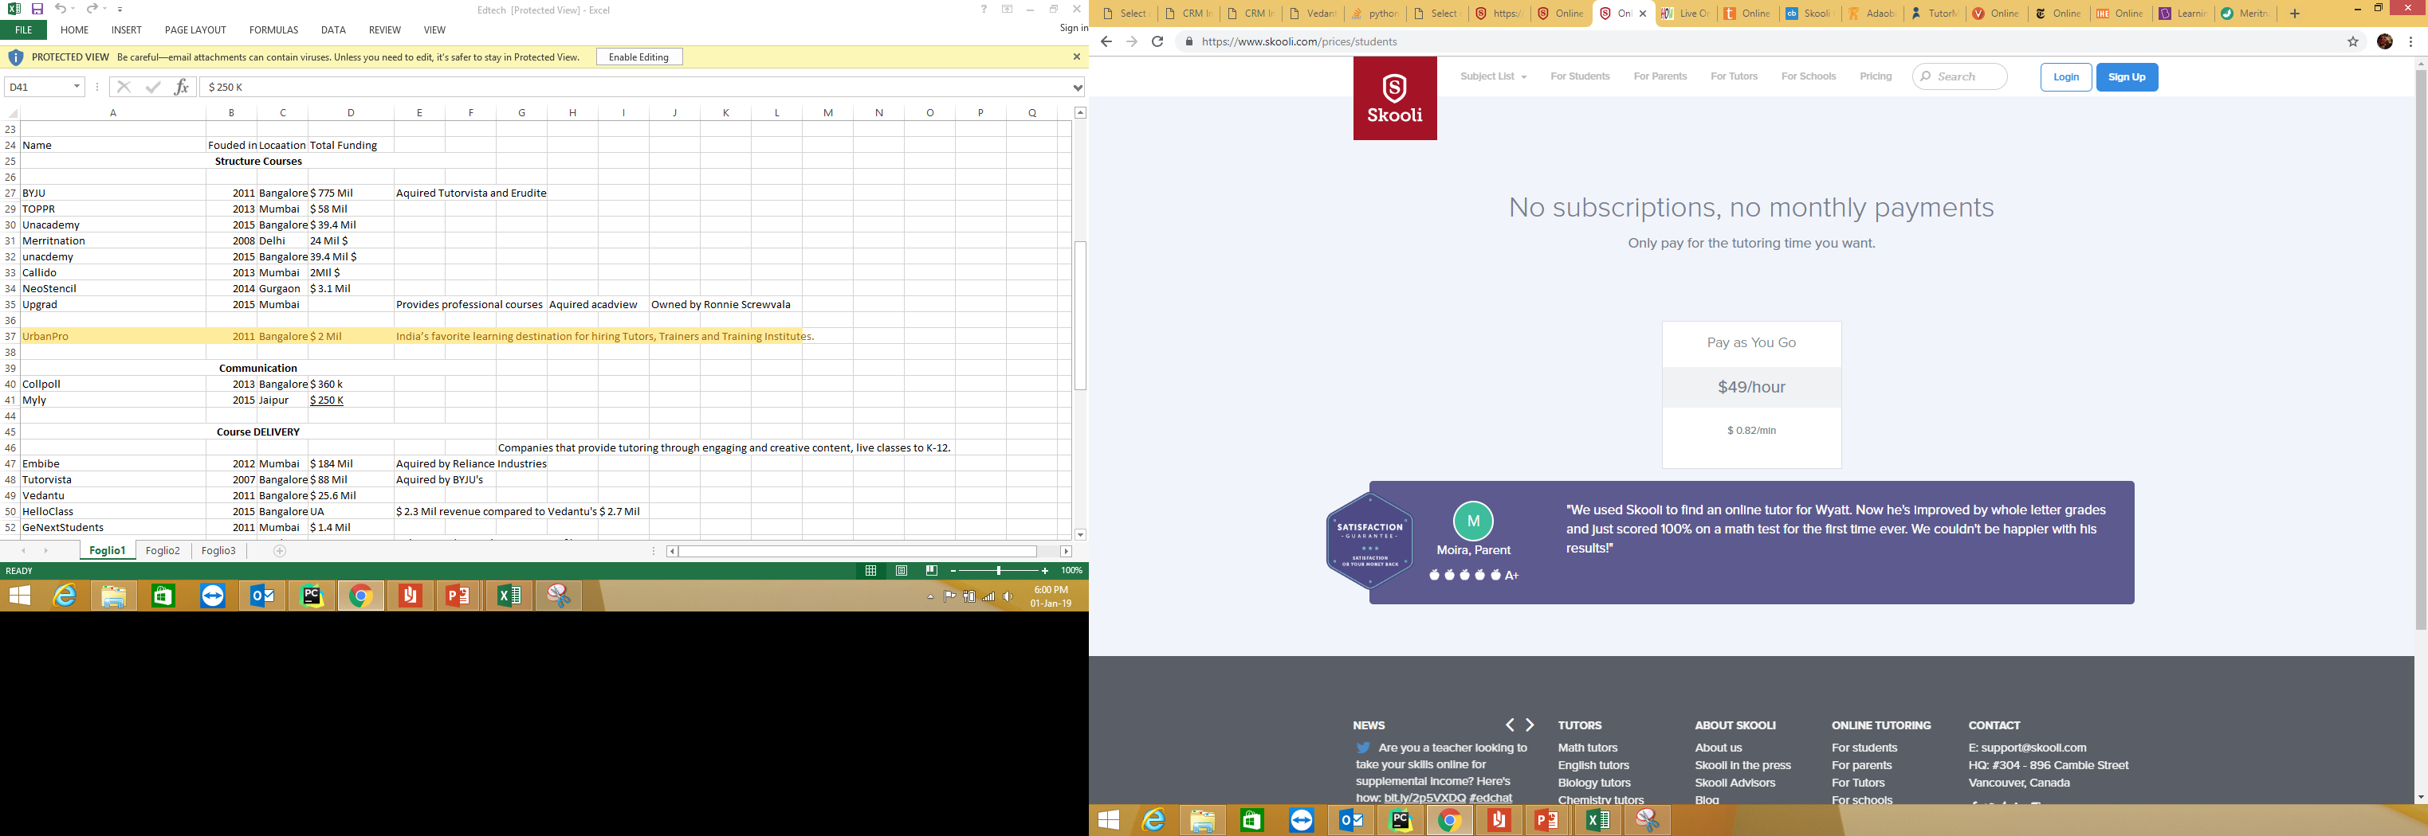
Skooli (2014,Vancouver)
Operates one to one model.
Focusing on removing the need of after school (brick and mortar) tutor services by bringing large no. of quality teachers & professors for K-12 to college and partnering with schools and institutions.

Slide 12
Vedantu
Company focus
Online tutoring for K-12 and competitive exams (NSO,IMO,NTSE,KVPY)
Competitors –
Meritnation
Tutor.com
Tutorvista.com
Chegg
TutorHub.com
Smarthinking (Aquired by Pearson Education)

Slide 13
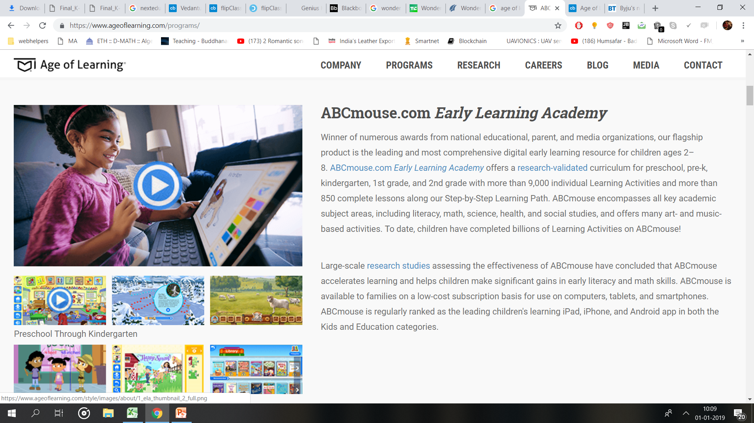
Vedantu Analysis
For students of class 6-8th
The students of this age group need physical face to face disciplined tutoring. Helping in their school subjects is one thing, but there's also the relationship aspect that is needed to be built between the teacher and the student.
The pricing is high - Rs 5000 for a 15hr course, i.e. Rs 10,000 month.
The USP of Vedantu is its unique model of having online 1-on-1 live student teacher sessions.
Globally Edtech players have focused on providing schools gamified creative content, class management & analytics. Ex- 17Zuoye (2007, Beijing, total funding -$585M, Series E) provides virtual classroom platform for K-12 students, parents and teachers. Age of Learning ($ 1 B, Los Angeles, 2007) provides a gamified comprehensive and engaging online curriculum for kindergarten and early elementary school programs.
Downside – Vedantu does not develop creative content. (All major players like Byju’s , Meritnation, Age of Learning do)

Slide 14

For 9-12th
Players like Meritnation started in 2006 providing online tutoring and resources. But the model has not shown slow success against the offline tutors. TutorVista (2005, acquired by Byju’s) is also a veteran.
There has been a boon in coaching industry, and big players like Fiitjee, Allen, TIME,etc have a very strong grip and huge demand by students of class 11, 12th and competitive exams. It is extremely difficult to break this segment (there are major players like Byju’s, Embibe, askIIITians.com, Unacdemy and free online resources and videos available).
Toppr.com ($ 110 Mil) also competes in the market segment and provides live doubt solving for students.

Slide 15
Growth ?
Providing quality education in remote areas is still a problem in India.
Poor Internet connection, and making lessons in regional languages are barriers.
After School tutoring is still avoided by parents who prefer their children to play and enjoy extra curricular activities at young age.
The relationship aspect that is needed to be built between the teacher and the student, is difficult to built from behind a camera.

